Slide 1
Climate and Hydrologic Modeling in Water Forward
TWRN Virtual Spring Meeting | May 19, 2021
Notes:
Helen and Marisa

Slide 2
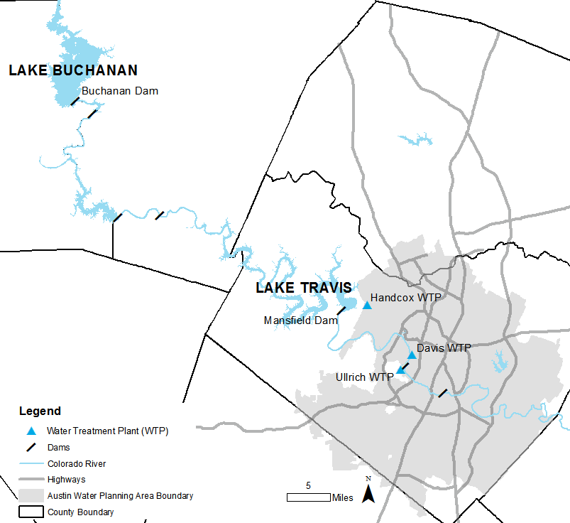
Austin Water Overview
Over 1 million customers served
~550 sq. mi. service area
Core supplies: Colorado River and Highland Lakes
Notes:
Helen

Slide 3
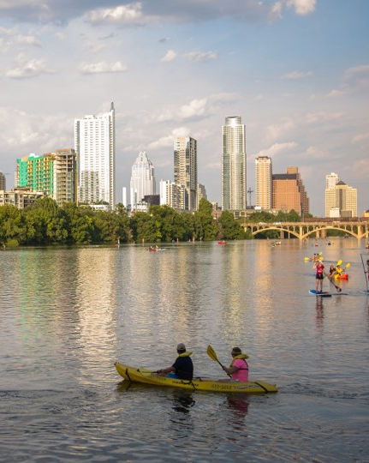
Water Forward Overview
Water Forward was approved by Council in November 2018
An Austin Water-led interdepartmental effort to develop a 100-year water plan that reflects our community’s values
Council-appointed Task Force met monthly
Community outreach throughout the plan development process
Goal is to ensure a diversified, sustainable, and resilient water future, with strong emphasis on water conservation
Notes:
Helen

Slide 4
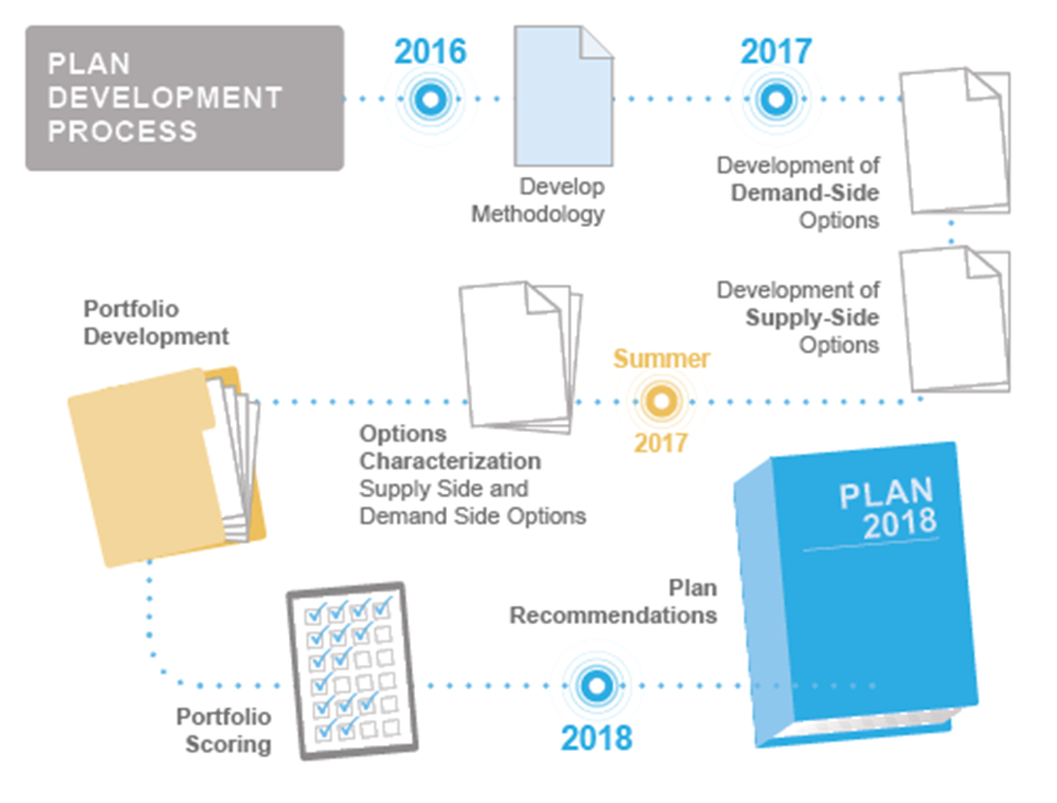
2018 Water Forward Development Process
Notes:
Helen

Slide 5
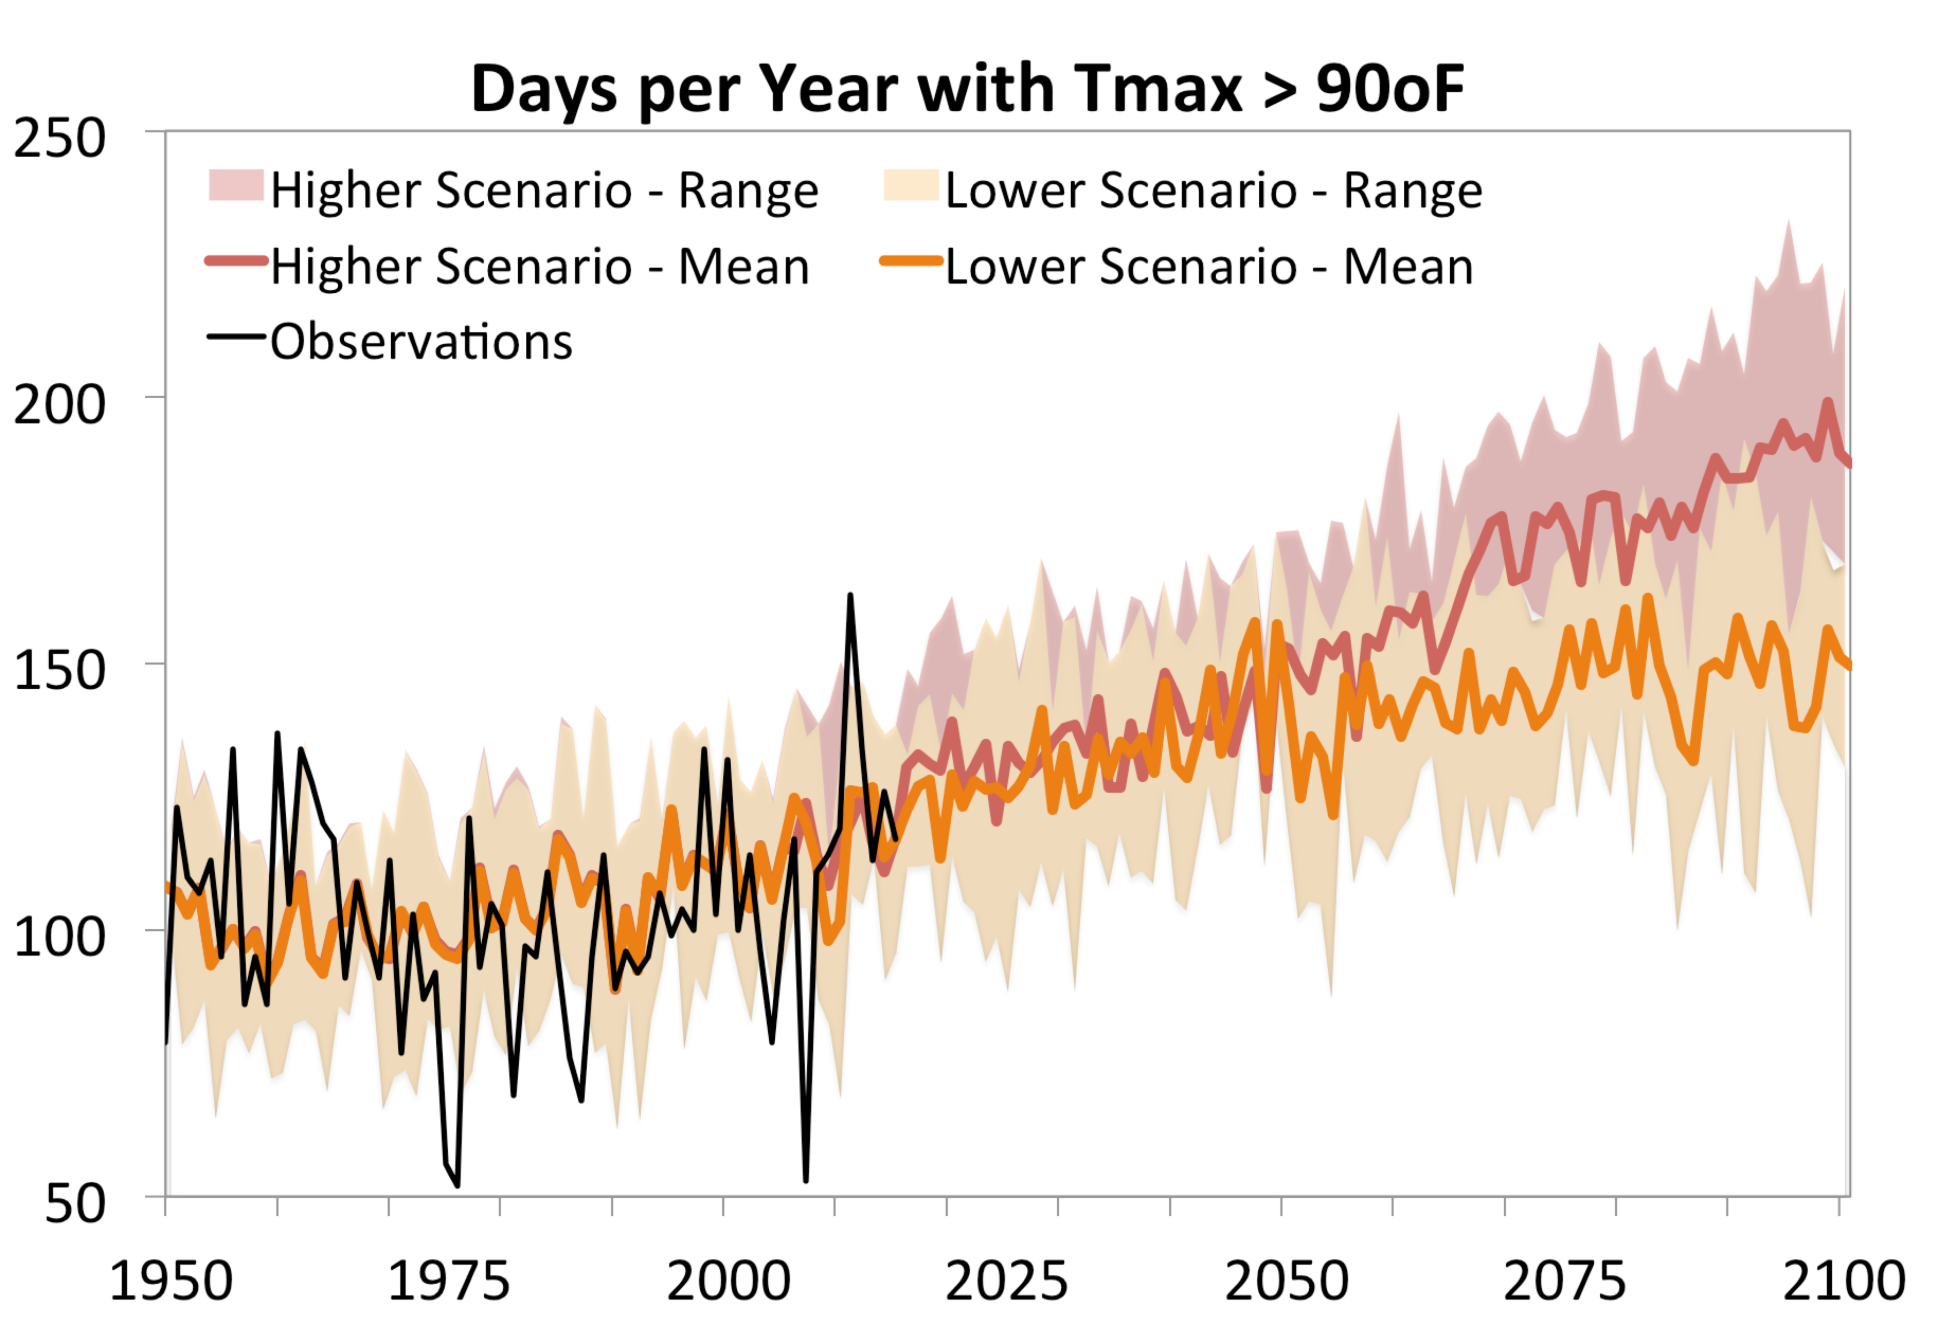
Climate change projections in Water Forward
Notes:
Helen?

Slide 6
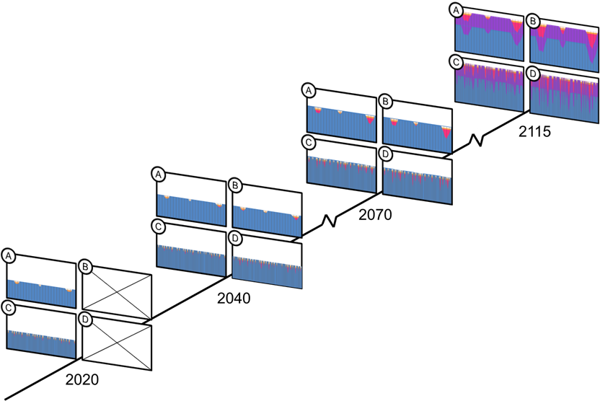
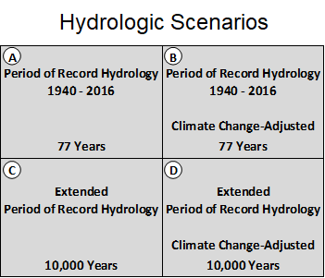
Climate and Hydrology Analysis Overview
Planning for future demands
under potential future hydrologic scenarios
Notes:
Marisa

Slide 7
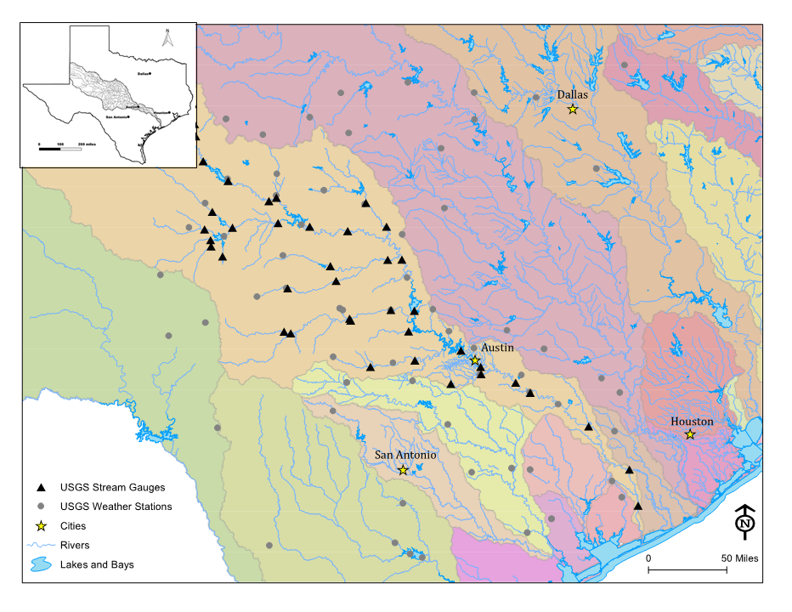
Climate Process continued
Notes:
Marisa

Slide 8
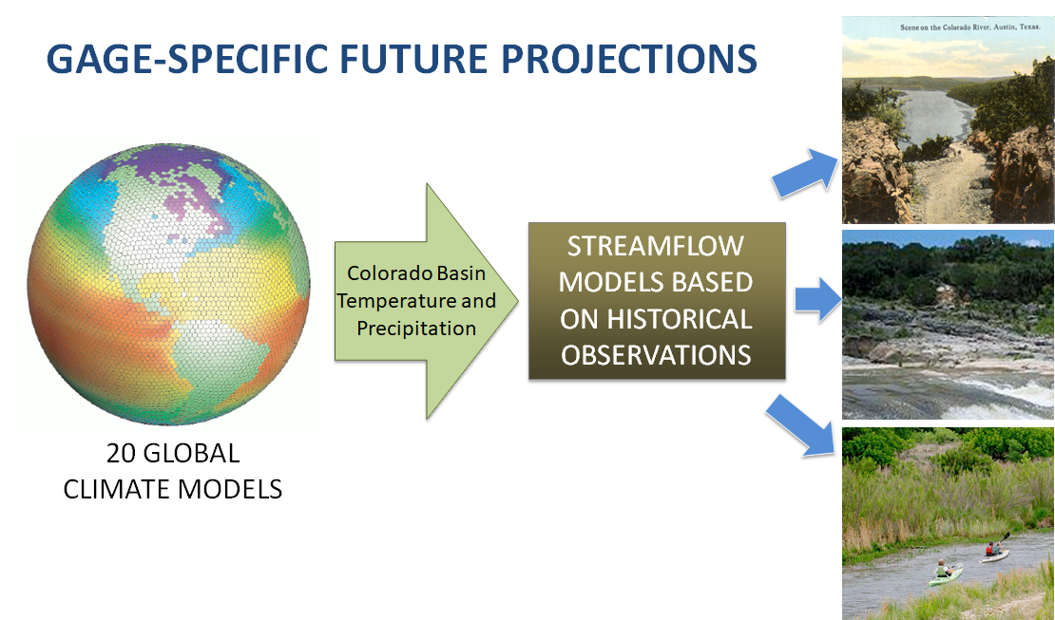
Climate Process continued
Notes:
Marisa

Slide 9
Climate-Adjusted Streamflows for WAM
Notes:
Marisa

Slide 10
Water Forward needs – 2070 with climate change
Year 1
Year 2
Year 3
Year 4
Year 5
Year 6
Year 7
Year 8
Year 9
Year 10
Notes:
Marisa

Slide 11
WF23 Climate & Hydrology Analysis Update
Updating climate and hydrology analysis to include new data and best practices
Formed a climate technical advisory group to provide input on analysis
Plan to begin updated analysis in fall 2021
Notes:
Helen?

Slide 12
Questions?
Notes:
Helen (or whoever presents slide right before this)

Slide 13
Key Drivers, and Guiding Principles of Water Forward
Protect
Feasibility
Align With
Imagine Austin
Focus On
Local Resources
Conservation
Core Colorado River Supplies
Environment
Public Health
Community Values
Regional Coordination
Reliability
Population Growth
Climate Resiliency
Historic Drought

Slide 14
Water Forward strategies
Demand Management
Supply
Implement Advanced Metering Infrastructure (AMI)
Enhance distribution system water loss control
Provide customer water use benchmarking information and implement water budgets
Transform to regionally appropriate landscapes Expand irrigation efficiency incentives
Store water for drought via Aquifer Storage and Recovery and a new Off Channel Reservoir
Bring on additional supplies via Brackish Groundwater Desalination
Expand the Centralized Reclaimed Water System
Use Indirect Potable Reuse as a deep drought strategy Capture local inflows to Lady Bird Lake
Use on-site and neighborhood scale alternative water sources for non-potable end uses
Rainwater, Stormwater, Wastewater, Graywater, and AC Condensate
Decentralized

