Slide 1
The Legislature + Water Todd H. Votteler, Ph.D., Texas Water Journal Robert E. Mace, Ph.D., Texas State University, Meadows Center for Water & the Environment
Texas Water Research Network Virtual Spring Meeting
May 19th, 2021

Slide 2
The Texas Legislature . . . What the Heck is Going On???

Slide 3
To Summarize The 87th Legislature Thus Far . . .
Lots of Drama, But
No Major Water Legislation
When Compared to the
Last 12 Sessions (Senate Bill 1 Passed in the 75th ).

Slide 4
Senate Committee on Water, Agriculture & Rural Affairs.
Senator Charles Perry (R), Lubbock, Chairman. Became Chairman in 2015
(Was a Freshman Senator).

Slide 5
House Committee on Natural Resources.
Representative Tracy King (D), Uvalde, Chairman.
First Session as Chairman. Originally Elected in 1994.

Slide 6
Now Here Are Some Numbers So Any Scientists Listening to This Presentation Will Be Happy.
By the Deadline for Filing New Bills During the
Regular Session on by the March 12th, The
Legislative Reference Library of Texas Reports that Almost
7,000 Bills & Joint Resolutions
Were Filed Compared to the
86th Legislature in 2019,
When Close to 7,300 Bills &
Resolutions Were Filed.

Slide 7
The Legislature Does More Than Consider and Pass Legislation.
Senate Confirms Former
Texas Water Development Board
Chairman, Peter Lake, as Chairman of
the Public Utility Commission.

Slide 8
The Legislature Does More Than Consider and Pass Legislation.
Governor Abbott Appoints
Brooke Paup as Chair of the
Texas Water Development Board.

Slide 9
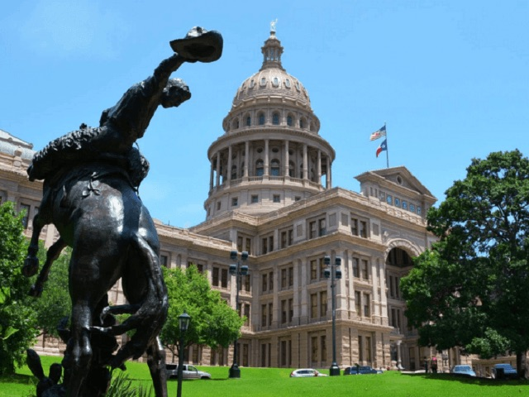
Now Some Bills.

Slide 10
SB 152 (Perry/Creighton).
Relating to the regulation of groundwater conservation districts [legal fees, petitioning for rule-making, etc.]. This is bill alters the Texas Water Code regarding groundwater conservation districts in a number of respects including as one of its most controversial elements the elimination of the right of groundwater conservation districts to recover attorney’s fees and other costs for litigation in which a district is sued and prevails in court, which would likely impede efforts by districts to regulate groundwater. Bill was passed by the Senate and yesterday by the House.

Slide 11
SB 601 (Perry/Creighton/Springer).
Relating to the creation and activities of the Texas Produced Water Consortium. Bill creates a consortium to study the use of produced water from oil and gas hydraulic fracturing for future use. Produced water is defined as the water that exists in subsurface formations, which is brought to the surface during oil and gas production. Bill was passed by the Senate and an amended version was just passed by the House.

Slide 12
HB 2225 (T. King/Guillen).
Relating to the powers and duties of the Parks and Wildlife Department regarding the Texas Water Trust. The Texas Water Trust is a repository for surface water rights to maintain in-stream flows and freshwater inflows to bays and estuaries. HB 2225 directs TPWD to encourage and facilitate the dedication of water rights to the Trust through lease, donation, purchase or other voluntary means and authorizes TPWD to manage the rights put into the Trust so as to maximize benefits for the environment. This bill was passed by the House, and yesterday there was testimony on this bill in Senate Water, Agriculture and Rural Affairs.

Slide 13
HB 2716 (T. King).
Relating to recommendations made by the Parks and Wildlife Department and intervention by the Parks and Wildlife Department in matters regarding certain permits. HB 2716 would restore TPWD’s authority to participate in contested case hearings on environmental permit applications, including surface water rights, to advocate on behalf of the state’s fish and wildlife resources. This bill was passed by the House and was referred to Senate Water, Agriculture and Rural Affairs.

Slide 14
HB 4146 (T. King).
Relating to a restriction on permits authorizing direct discharges of waste or pollutants into water in certain stream segments or assessment units. This bill prohibits wastewater discharge into stream segments that include, but are not limited to, the Llano, Pedernales, Comal, Guadalupe, Medina, Nueces, and San Marcos Rivers, as well as Barton Creek and Onion Creek. This bill has been passed by the House and received by the Senate, but not assigned to a committee yet.

Slide 15
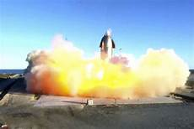
Climate Change Bills.

Slide 16
Robert Mace’s New Pool.

Slide 17
Todd Votteler’s Pool.

Slide 18
We Are in the Final Weeks of the Session When it is Difficult to Determine What is Actually Happening.
The Regular Hearing Schedule is
Out the Window and Sometimes
Hearings Are Just Legislators Crowded
Around the Chairman’s Desk, and
Sometimes There Isn’t Even a Desk.

Slide 19
May 31st is the Last Day of the Regular Session.
Every Legislator is Trying
to Get Through Bills
Through the Process.
We Still Don’t Have an
Approved Budget (SB 1),
the Only Bill the
Legislature Must Pass!

Slide 20
WARNING! Shameless Plug! For Additional Updates on the 87th Session Read Our Lege+Water Feature in Texas+Water.

Slide 21
WARNING! Shameless Plug #2! Really Want to Know What Happened During the 87th Session of the Texas Legislature?
Read the 87th Texas State Legislature:
Summaries of Water-Related
Legislative Action in the
Texas Water Journal.
Coming this Summer!

Slide 22
Questions?

