Slide 1
May 2021
Cascading Impacts of COVID-19 on Water Infrastructure Systems
Texas Water Research Network Meeting
Lauryn Spearing
Graduate Student, The University of Texas at Austin

Slide 2
Project background
Understand how social distancing has impacted water utility management and operations
Funded by an NSF RAPID grant (Award Numbers: 2032434/2032429/DGE-1610403)
Dr. Kasey Faust
Dr. Jessica Kaminsky
Dr. Lina Sela
Dr. Lynn Katz
Dr. Mary Jo Kirisits
Dr. Kerry Kinney
Matt Landsman
Emma Palmer
Helena Tiedmann
David Jarma
Nathalie Thelemaque

Slide 3
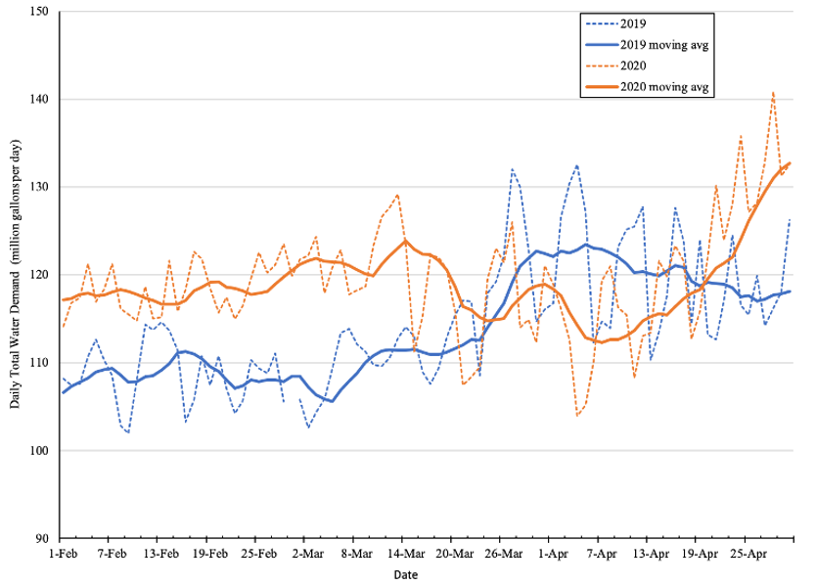
Impact of social distancing policies on water systems
Social distancing policies may lead to:
Operating outside of design conditions and financial capacities
New management challenges
Potential for operational issues (e.g., pressure, pipe breaks)
Changes in water use
Local Social Distancing Policies Enacted
Source: Amal Bakchan, 2020

Slide 4
Local Social Distancing Policies Enacted
Source: Amal Bakchan, 2020

Slide 5
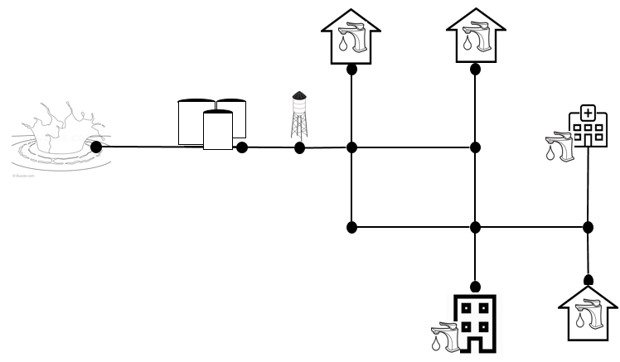
Water system changes during social distancing policies
Late Payments
COVID-19 Social Distancing Policies
Workforce
Changes
Demand Change

Slide 6
How did the water distribution system operations change?
The pandemic raises many questions
Did utilities’ financial state change?
Were there water quality issues?
Did water utilities face management challenges?
Were customers paying their bills?
Did customers use water differently?

Slide 7
Objective 2:
Water quality at the users’ taps
Objective 3:
Changes in distribution system hydraulics
Project objectives
Objective 1:
Utilities’ experiences and response
Objective 4:
Water use changes at the building level
How did spatiotemporal changes in demand driven by the pandemic impact water infrastructure?

Slide 8
Today’s focus
Objective 1:
Utilities’ experiences and response

Slide 9
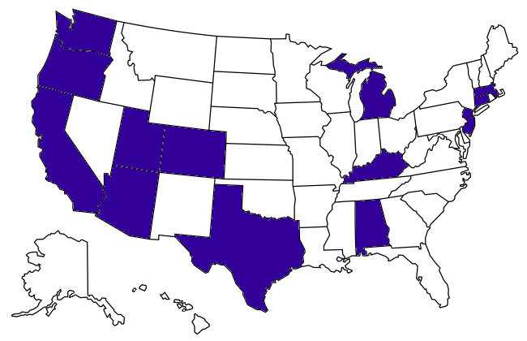
Spearing et al. 2020
Semi-structured interviews with US utilities
Research Objectives:
Challenges faced or changes to system operations
Utilities’ response to identified challenges or changes
Methods:
30 interviews with 28 utilities in 13 states
Insight from over 50 employees
Qualitative analysis

Slide 10
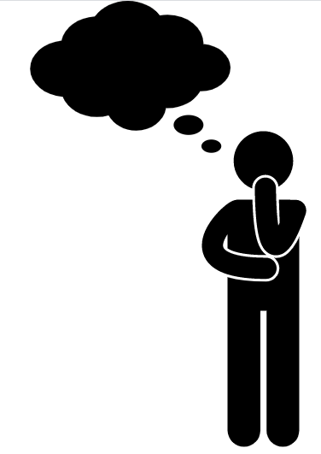
Qualitative analysis
Qualitative coding: systematically identifying themes in qualitative data
Code: word or short phrase that symbolically assigns a summative, essence-capturing attribute for a piece of text (Saldana, 2013)
Allows us to:
Abstract and understand uncertain systems
Make objective conclusions by aiming to remove bias
Create replicable research

Slide 11
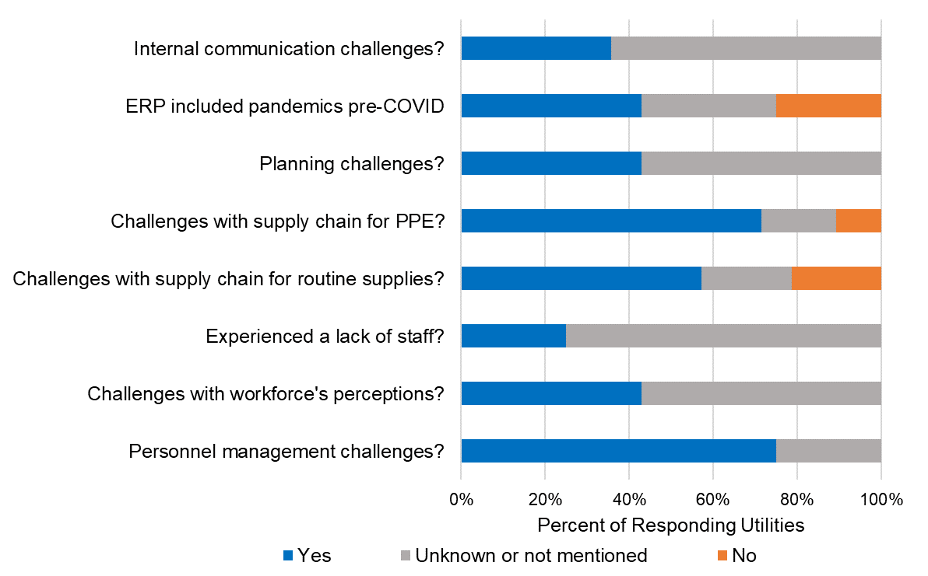
Spearing et al. 2020
Planning & management challenges

Slide 12
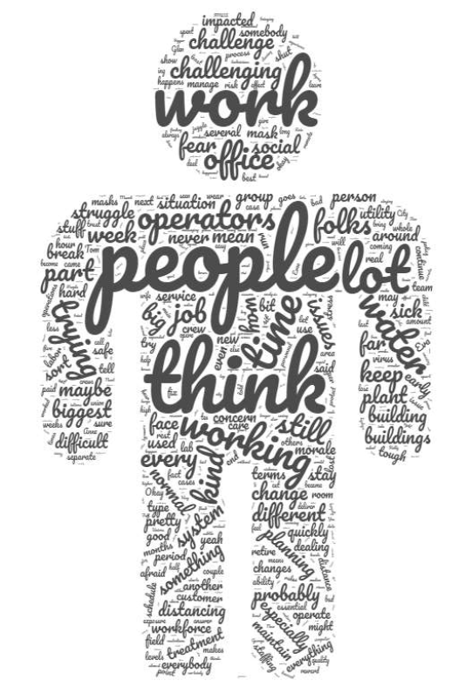
Spearing et al. 2020
Challenges evident when managing workforce
Challenges:
Administrative work for managers
Ensure operators were able to work
Staff morale
Response:
Split staff into shifts; standby crews
Operations facilities made restricted access
Vehicle policies
“We quickly realized it was a labor management administrative nightmare.”

Slide 13
Spearing et al. 2020
Planning & management challenges

Slide 14
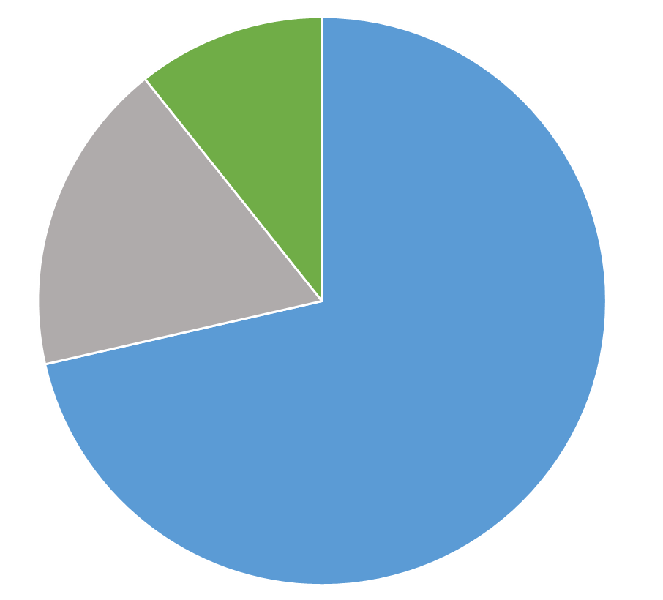
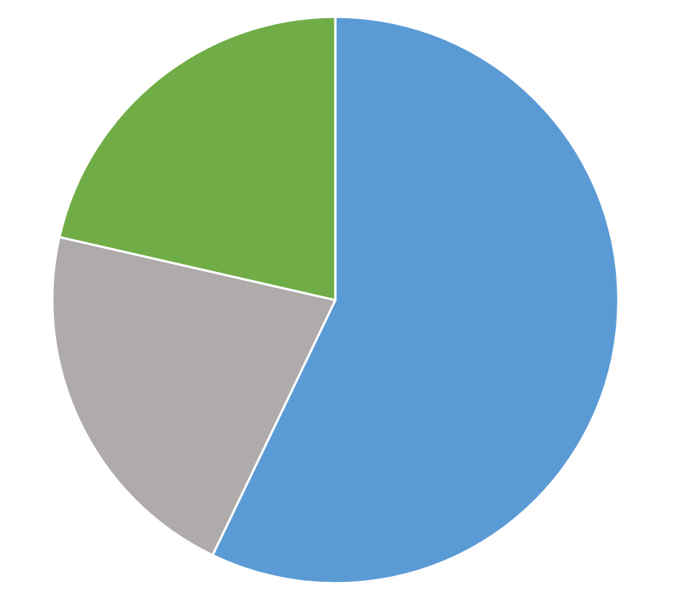
Spearing et al. 2020
Supply chain challenges & response
Challenges:
Procuring personal protective equipment (PPE)
Increased planning to ensure supply chain was reliable
Response:
Ordered extra materials
Priority customer
Made PPE in house
Challenges with…
PPE
Routine Supplies
No
No
Unsure
Unsure
Yes
Yes
“We did order some specialty valves from Italy. Suffice to say, we haven't got them in yet.”

Slide 15
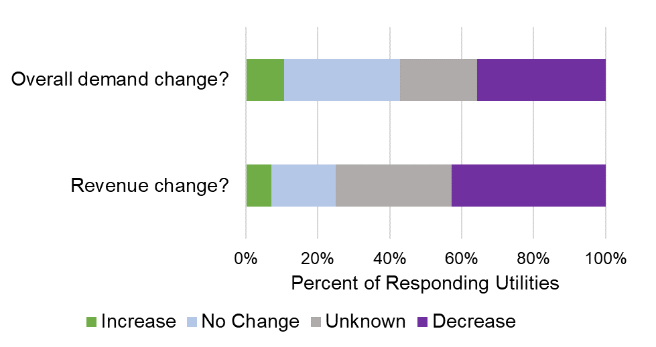
Spearing et al. 2020
Changes in demand and revenue
Shift from commercial/industrial to residential demand
Emergent challenges dependent on customer composition
Revenue change impacted by delinquent accounts – 46% of utilities saw an increase
College towns similar to winter break
Demand patterns changed
“Our residential numbers…everything looks like a weekend.”

Slide 16
Spearing et al. 2020
Changes in demand and revenue
Shift from commercial/industrial to residential demand
Emergent challenges dependent on customer composition
Revenue change impacted by delinquent accounts – 46% of utilities saw an increase
College towns similar to winter break
Demand patterns changed
Led many utilities to postpone capital projects and non-critical maintenance

Slide 17
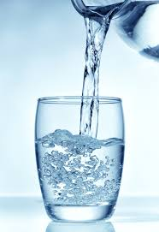
Spearing et al. 2020
Impacts on water quality & testing
Majority of utilities didn’t experience changes in disinfectant residuals or water quality challenges – reveals resiliency
Challenges:
Testing with limited staff
Issues coordinating with labs
Supply chain issues with lab materials
Response:
Changed testing locations from households
Delayed non-regulatory testing
Source: ETR Laboratories

Slide 18
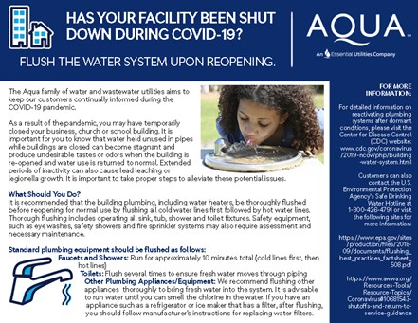
Spearing et al. 2020
Community-related impacts
Challenges:
Increase in customer complaints
Communication challenges
Response:
Increased outreach about safety and flushing protocols
Customer service remote or drive-through
Benefits of Social Distancing: Customers are more aware of the water system
Source: AQUA America, Inc. & Otay Water District

Slide 19
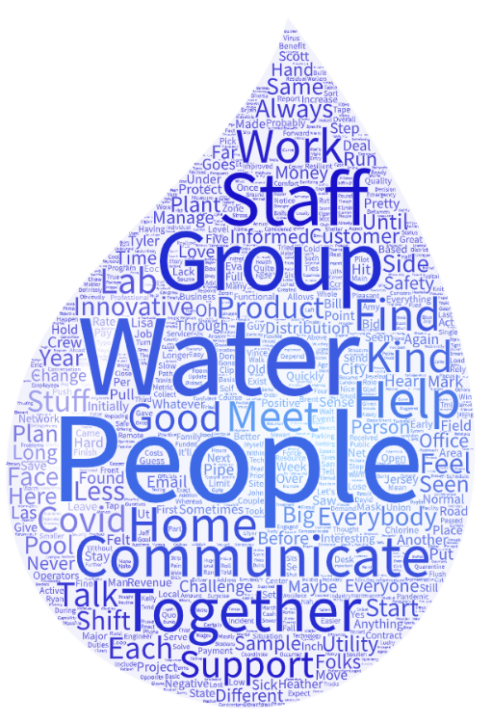
Spearing et al. 2020
System benefits of social distancing & lessons learned
Benefits:
More compassionate working environment
Increased productivity when teleworking
More public involvement
Lessons:
Improved planning for future pandemics
Response plans now incorporate workforce challenges
Improved flushing protocols

Slide 20
Spearing et al. 2020
Key takeaway: COVID-19 could lead to future repercussions
COVID-19 Issues
Existing Issues
Decrease in federal infrastructure funding
Lack of investment in infrastructure
Decreased revenue & financial issues
Postpone capital projects
Aging water infrastructure & future resiliency

Slide 21
Acknowledgements
Faculty and students from The University of Texas at Austin and the University of Washington
Participating utilities and municipalities

Slide 22
Questions?
Contact Information
Lauryn Spearing
lspearing@utexas.edu

Slide 23
References
Saldaña, J. (2013). The Coding Manual for Qualitative Researchers (2nd Ed.). SAGE Publications Inc. (2nd ed.). London: Sage Publications. https://doi.org/10.1017/CBO9781107415324.004
Spearing, L. A., Thelemaque, N., Kaminsky, J. A., Katz, L. E., Kinney, K. A., Kirisits, M. J., … Faust, K. M. (2020). Implications of Social Distancing Policies on Drinking Water Infrastructure : An Overview of the Challenges to and Responses of U.S. Utilities during the COVID-19 Pandemic. Environmental Science & Technology Water. https://doi.org/10.1021/acsestwater.0c00229

