Slide 1
Welcome to the
Texas Water Research Network
May 19, 2021
Virtual Spring Meeting
University of Texas at Austin
  Sponsored by The Cynthia & George Mitchell Foundation, www.cgmf.org

Slide 2
Goals for meeting
Provide a setting for new and existing members
to network
Provide learning opportunities on key issues related to Texas water resources
Promote effective interactions between researchers, stakeholders, and decision makers

Slide 3
TWRN Mission
Bringing researchers together in addressing the resilience of Texas water resources to changes in natural and human systems, and to improve connections between researchers, stakeholders, and policy makers

Slide 4
TWRN Meetings Evolution
  May 2015: Network purpose and niche
  December 2015: Grand challenges, mission
  August 2016: Nodes and network efficacy
  May 2017: Science of communication, key issues
  for policy makers and managers
  January 2018: Science-stakeholder interaction in
  producing research
  September 2018: Water markets, flood resilience
  May 2019: Water technologies, climate projections
  May 2021: Polar vortex, COVID, vulnerable communities

Slide 5
TWRN: Where do we go from here?
2021-2022: Quarterly virtual meetings convened around research topics of timely societal significance
Re-engage existing membership and increase representation of URM members
Workshop within meeting to synthesize key findings for communication (Environmental Science Institute website, white paper, journal articles, etc.)
Positioning TWRN expertise to aid in decision making for future water resilience

Slide 6
Grand Challenges
What forcing factors and feedbacks drive the coupled natural-human system that comprises a rapidly-growing
and demographically-shifting sentinel community in a climatically-sensitive region (100th Meridian)?
How can we project the impacts of the natural and human systems on each other to produce a regional-scale assessment of urban water resiliency that can be used to inform effective solutions through education, policy and technology?

Slide 7
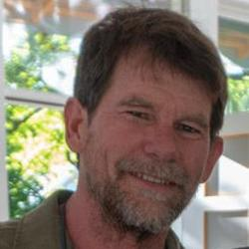
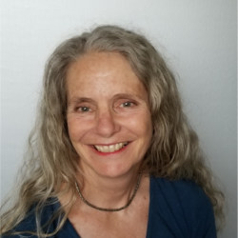
Pete van Metre & Barbara Mahler
https://www.caringbridge.org/visit/barbaramahler

Slide 8
Texas Water Research Network
  Facilitation Team
  Darrel Tremaine, Patrick Bixler, Robert Mace, Josh Katz, Jay Banner

